Slide 1
Business Intelligence: A Visual Application of Data
Tableau:
Data Cleaning Excel Spreadsheets and Datasets

Slide 2
Data Cleaning Formatted-to-Raw Data
Extracted data may be in a formatted state, containing:
Headings
Groupings
Calculations
Empty rows or cells
To visualize spreadsheet data properly, Tableau requires formatted data to be transformed into raw data

Slide 3
Data Cleaning Formatted-to-Raw Data
Underlying data points that have been summarized or aggregated into a group or order cannot be seen by Tableau
The formatted data must be normalized – the data must be presented as raw data before connecting to it from Tableau

Slide 4
Data Cleaning Formatted-to-Raw Data
Transforming formatted data into raw data requires data repetition
In some columns (not all)
Resulting in a single value(s) for pertinent attributes
Dependent upon data discovery objectives
Usually performed manually
But can be assisted with an add-in

Slide 5
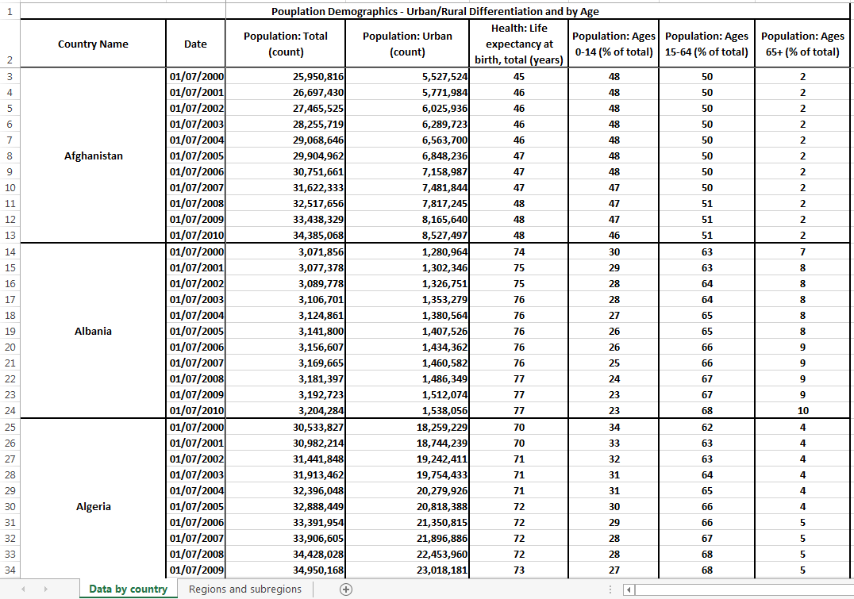
Data Cleaning Formatted Data Example

Slide 6
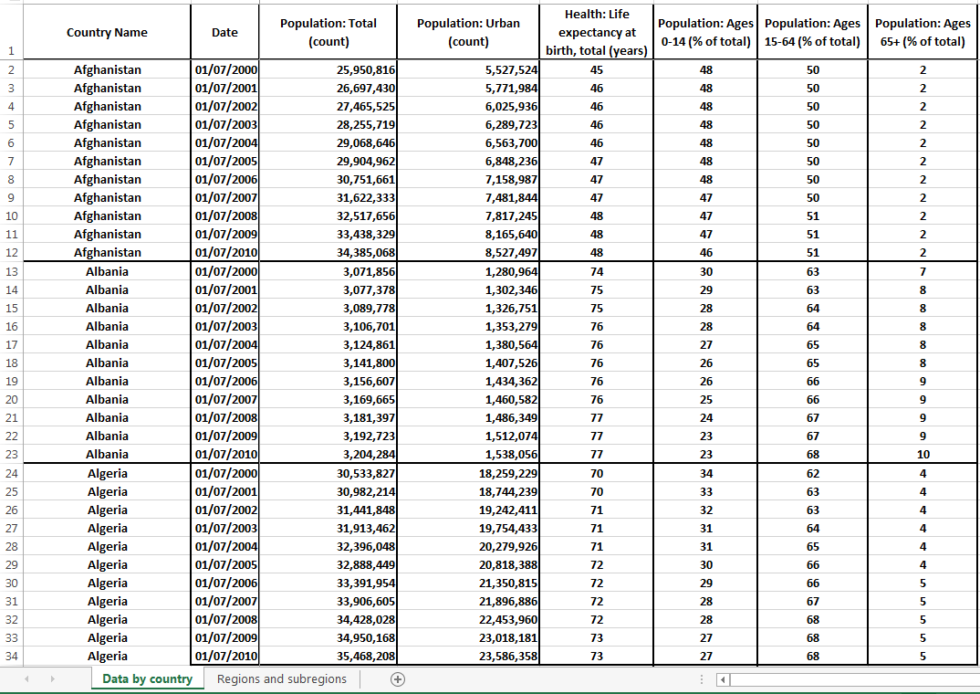
Data Cleaning Formatted-to-Raw Data Example

Slide 7
Data Cleaning – General Rules
Following information taken from Tableau
copy and paste link:
http://kb.tableausoftware.com/articles/knowledgebase/preparing-excel-files-analysis
Remove introductory and other unnecessary text
first row in the entire file must contain field headers (or column names)
Each row must contain only one piece of data

Slide 8
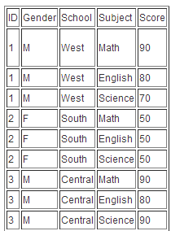
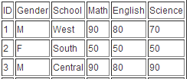
Data Cleaning – General Rules
Each row has single data values

Slide 9
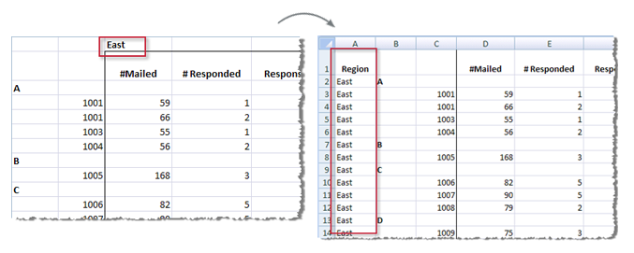
Data Cleaning – General Rules
Headers should be in one row only
This row should be the only row of headers.

Slide 10
Data Cleaning – General Rules
Fill blank cells
All cells must be filled
information is repeated for each row of data, not just the first occurrence
each record (or row) must have data across all the columns
If cells are merged, must split or “unmerge” into individual cells

Slide 11
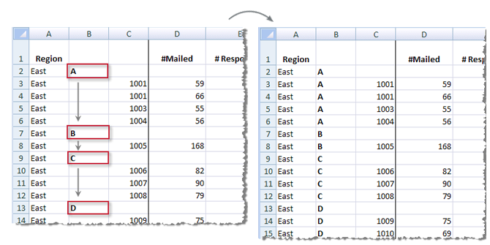
Data Cleaning – General Rules

Slide 12
Data Cleaning – General Rules
Clean up aggregated, calculated or descriptive data
Aggregations (averages, percentages, etc.) and calculations (summations, totals, etc.) are easily calculated by Tableau
Labels, comments, titles, etc. must be removed – again, Tableau allows for the creation of such descriptive data

Slide 13
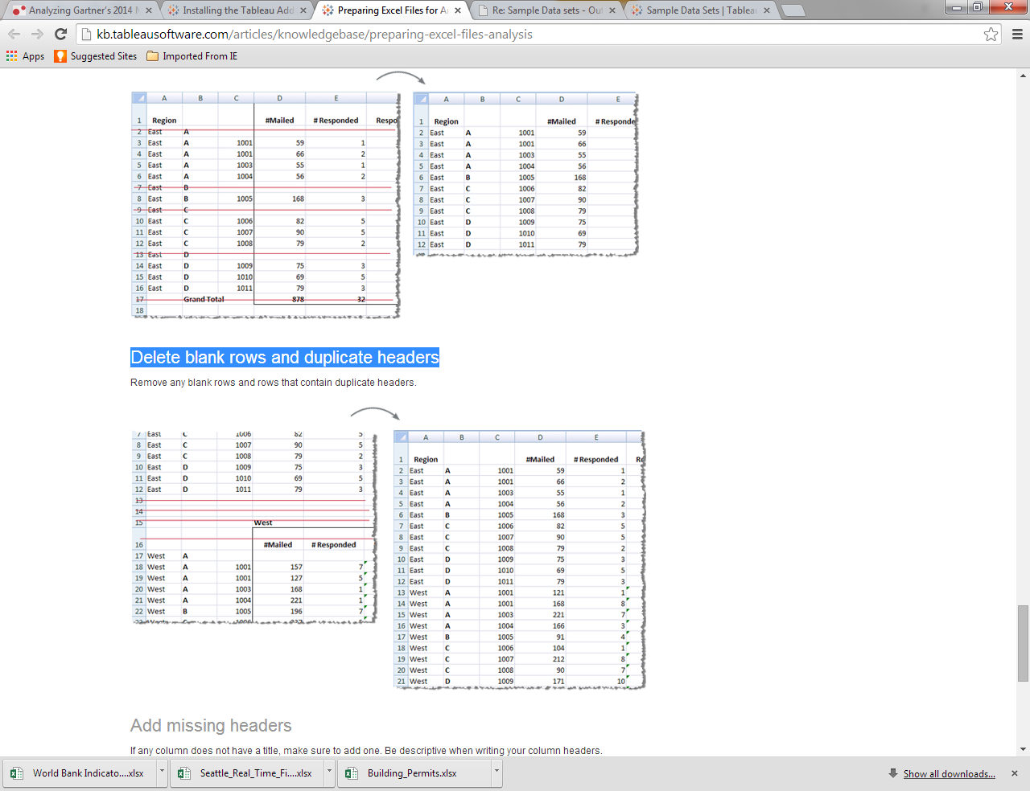
Data Cleaning – General Rules

Slide 14
Data Cleaning – General Rules
Delete blank rows and duplicate headers

Slide 15
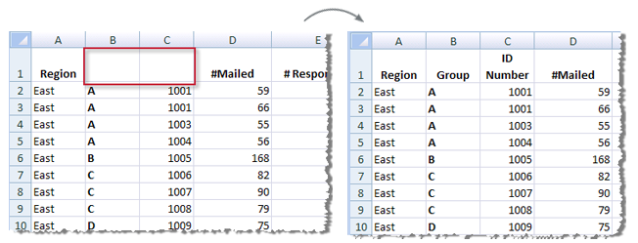
Data Cleaning – General Rules
Every column must have a title, or header (the more descriptive, the better)

Slide 16
Data Cleaning – General Rules
Following the aforementioned steps will assist in transforming formatted data into raw data
However, areas in the formatted data may have been missed or over-looked
Or not formatted for optimal Tableau efficiency/functionality
Tableau provides an Excel plug-in to help re-shape your data
NOTE: you still must undertake the data cleaning steps mentioned in the earlier slides

Slide 17
Data Cleaning – Excel Plug-In
The following installation steps are taken from the Tableau Excel plug-in site:
Access the Excel plug-in link and download the Excel add-in that is attached to the article
file name: tableau_data_tool.zip
Copy and paste link:
http://kb.tableausoftware.com/articles/knowledgebase/addin-reshaping-data-excel
Go to the location you downloaded the Tableau add-in, open the tableau_data_tool.zip file
double-click the file to install the add-in
file name: Setup-Tableau-Add-In-7.0.exe
Follow the Wizard instructions and click on “Finish”

Slide 18
Data Cleaning – Excel Plug-In
Open Excel
Click the File tab, click Options, and then click Add-Ins.
From the Manage box, select Excel Add-ins
Then click Go.
In the Add-Ins dialog box, verify the check box next to the Tableau add-in is selected
Click OK.

Slide 19
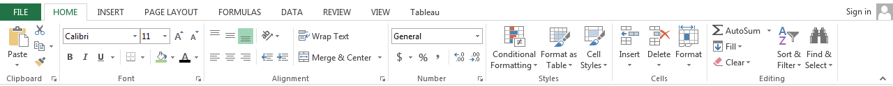

Data Cleaning – Excel Plug-In
The Excel menu bar will now have a Tableau tab:
Click on the Tableau tab to view the Tableau menu

Slide 20
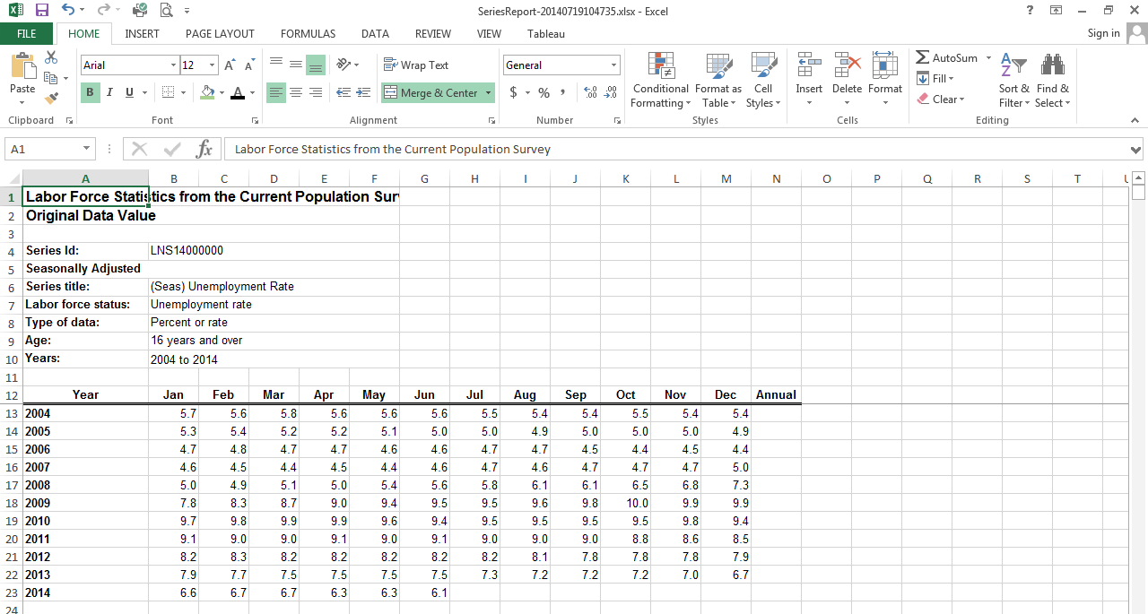
Data Cleaning – Formatted Data

Slide 21
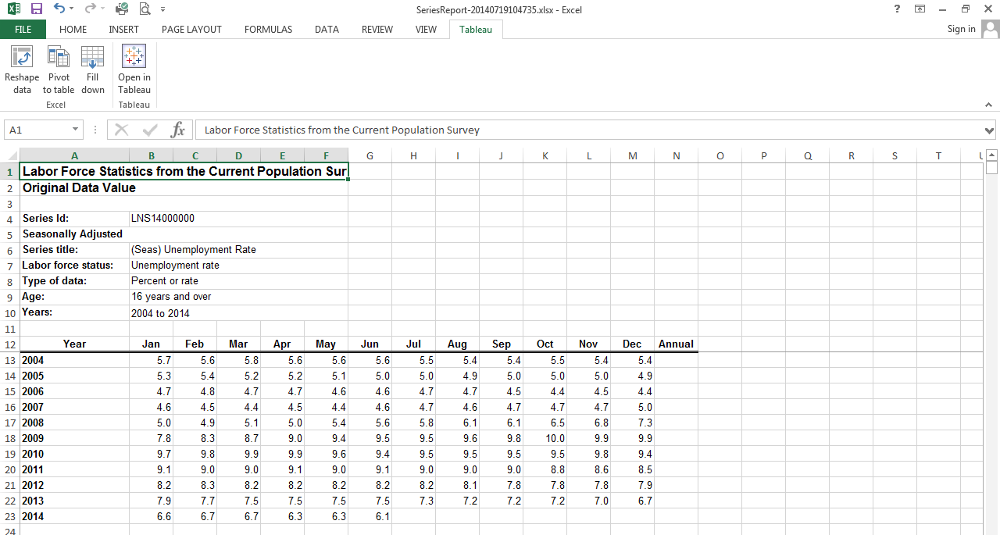
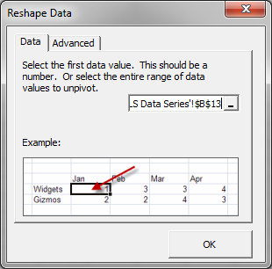
Data Cleaning – Reshaping Data Tool

Slide 22
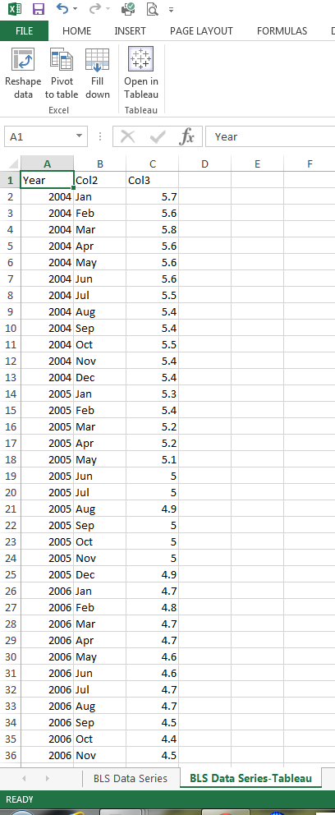
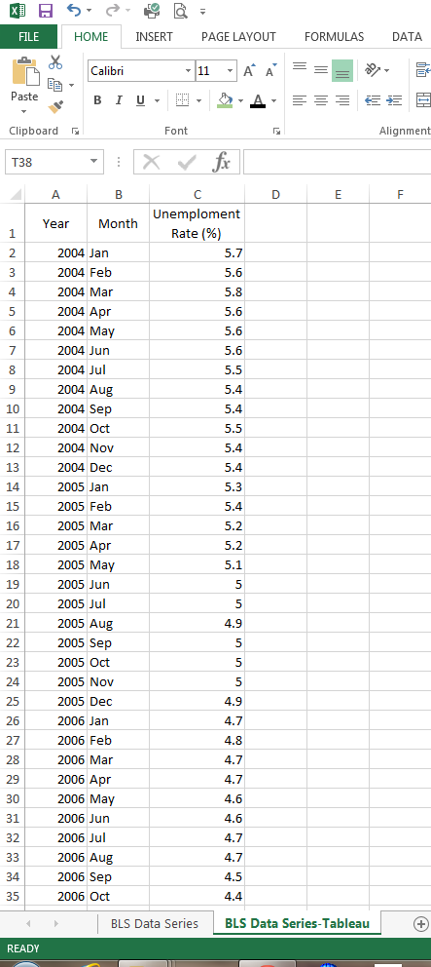
Data Cleaning – Reshaped Data
After reshaping data:
Column headings must be labelled with appropriate titles
Original dataset file remains unchanged
(reshaped data on new worksheet)

Slide 23
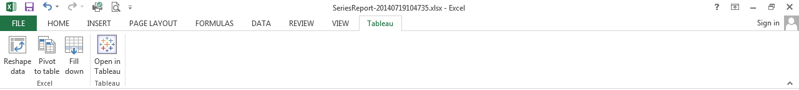
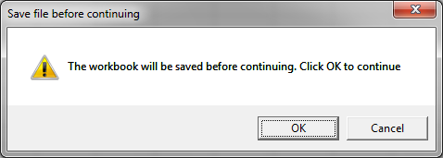
Data Cleaning – Excel Plug-In
Can automatically open dataset in Tableau by selecting “Open in Tableau” menu option
Workbook will be saved automatically

Slide 24
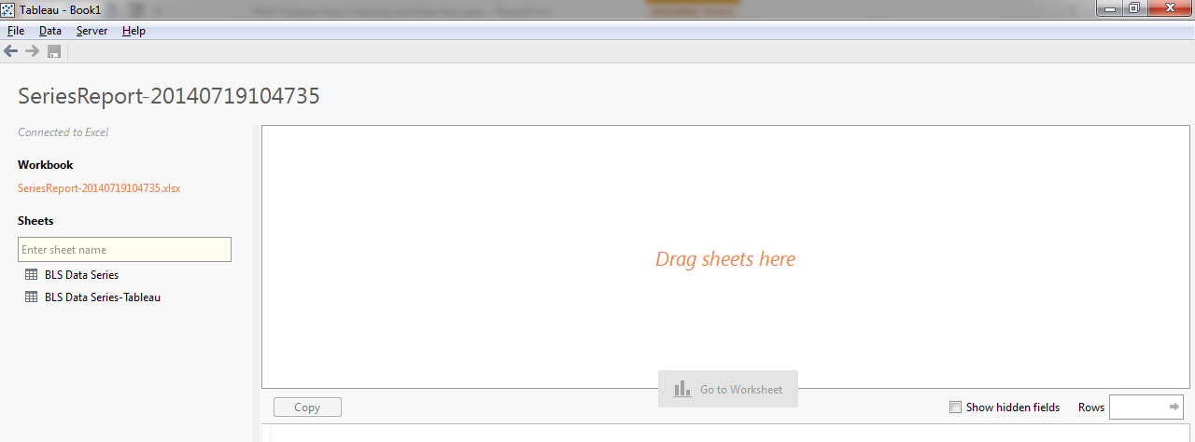
Data Cleaning – Tableau Workbook
Drag desired worksheet into work area

Slide 25
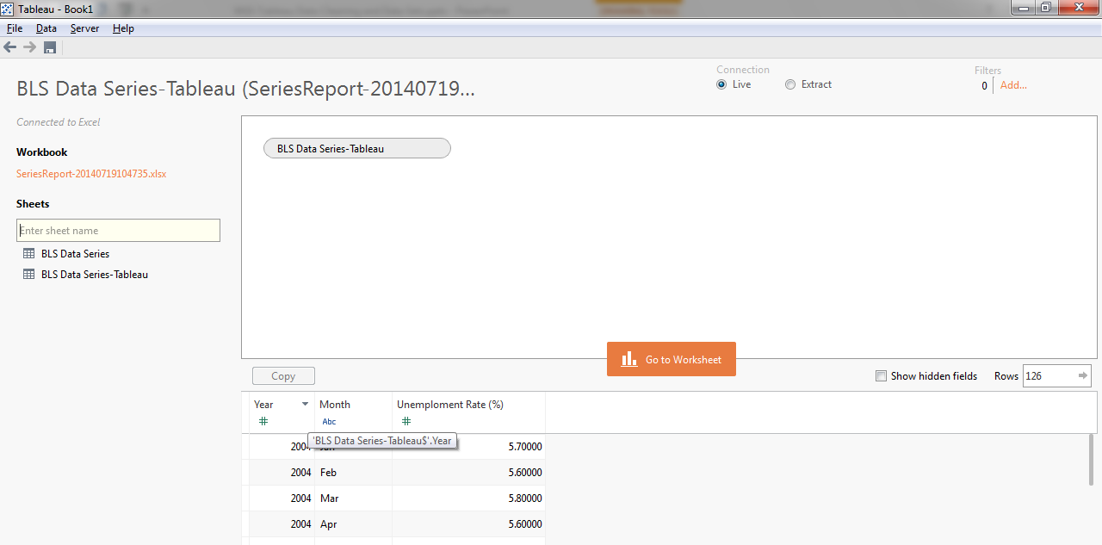
Data Cleaning – Tableau Workbook
Click on “Go to Worksheet”

Slide 26
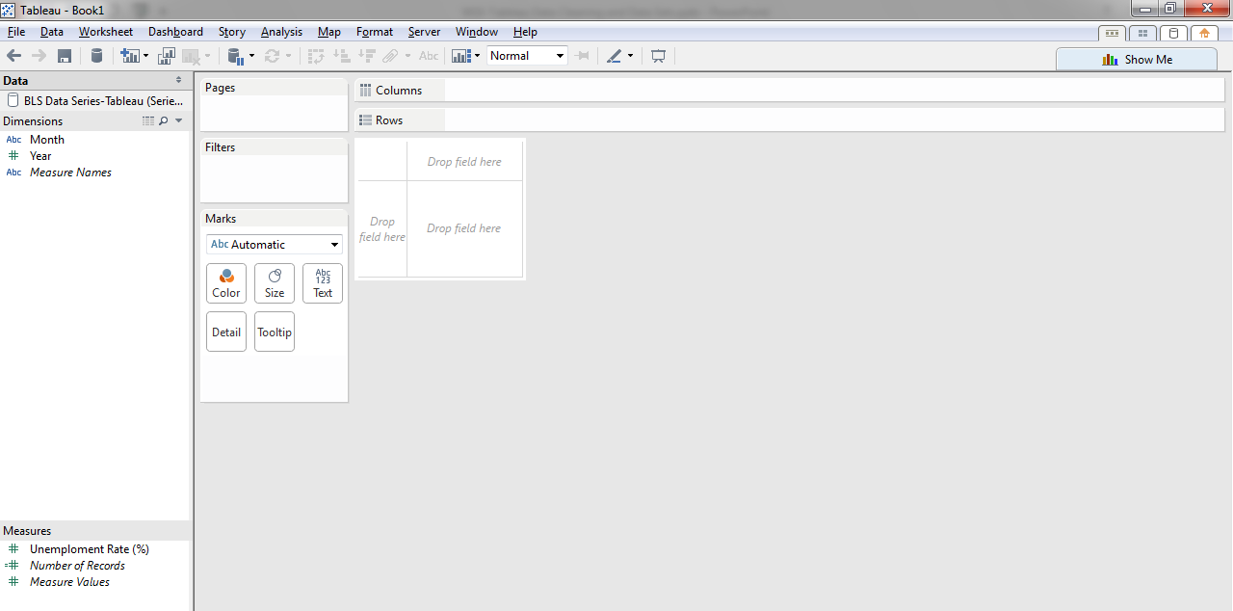
Data Cleaning – Tableau Workbook
Data placed in Tableau

Slide 27
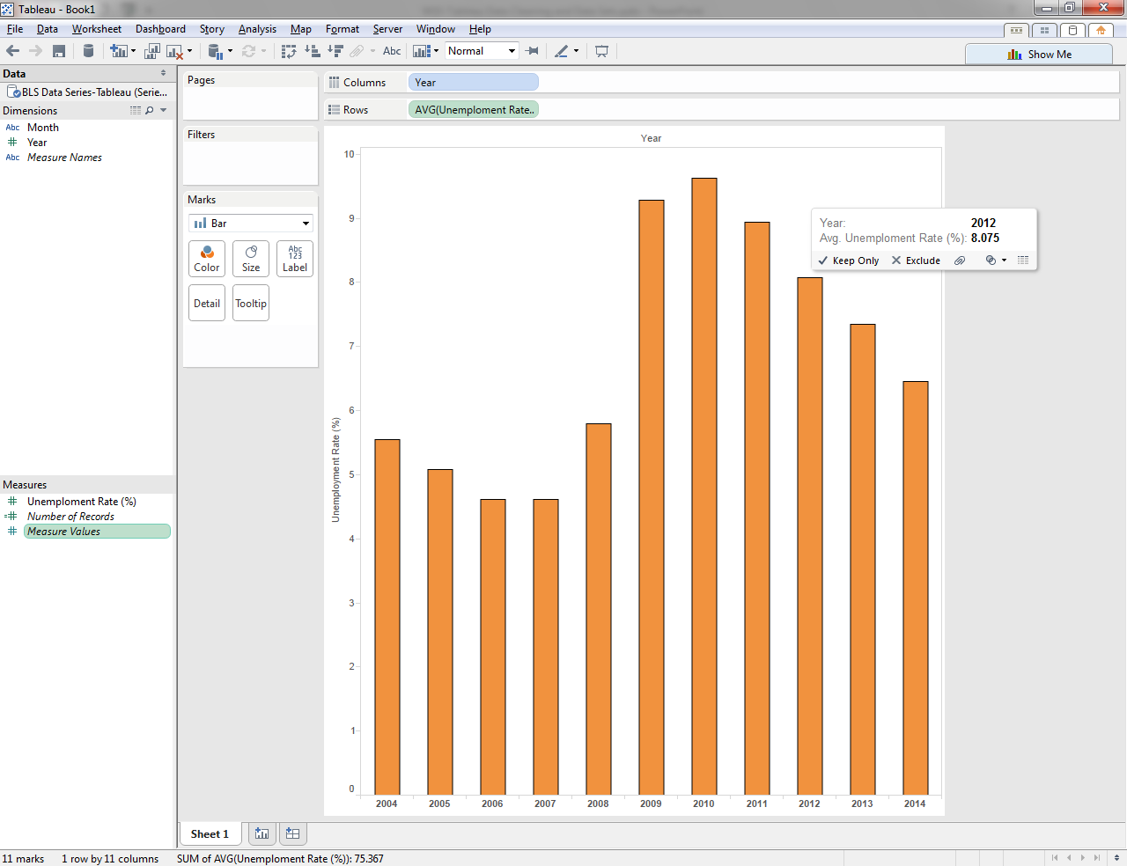
Data Cleaning – Tableau Workbook
Drag Dimensions and Measures into Tableau workbook

Slide 28
Data Cleaning – Datasets
For the purposes of this course, the majority of available datasets have already been transformed to raw data
But use the reshaping tool to optimize the data before connecting to Tableau
Apart from the sample datasets made available when the Tableau Reader and Desktop were installed, there are several other areas where datasets can be retrieved (see Blackboard dataset links).

